Slide 1

Social Media Usage and Impact

Slide 2
The Global Landscape of Social Media
Social media has fundamentally reshaped how people communicate, consume information, and interact with the world. Its usage continues to grow exponentially across all demographics and geographies.
5.04B
4h
10%
Active Users
Daily Average
Annual Growth
Globally, over 5 billion people are active social media users, representing more than 62% of the world's population.
The average user spends nearly 4 hours per day across various social platforms.
The number of social media users is increasing by approximately 10% year-over-year.

Slide 3


Key Platforms and Their Dominance
Different platforms serve different purposes and demographics, leading to varied usage patterns and impacts.
Facebook & Instagram
TikTok
Remain dominant for general social networking, brand building, and advertising, especially among older demographics.
Leads in short-form video content and has a massive influence on youth culture and viral trends.

Slide 4
Impact on Communication and Relationships
Social media has revolutionized personal communication, offering both benefits and challenges to relationships.
Instant Connectivity
Digital Overload
Shallow Interactions
Allows for immediate communication across geographical boundaries, maintaining long-distance relationships easily.
The constant stream of notifications and updates can lead to communication fatigue and distraction.
Critics argue that digital interactions often replace deeper, face-to-face connections, leading to loneliness.

Slide 5
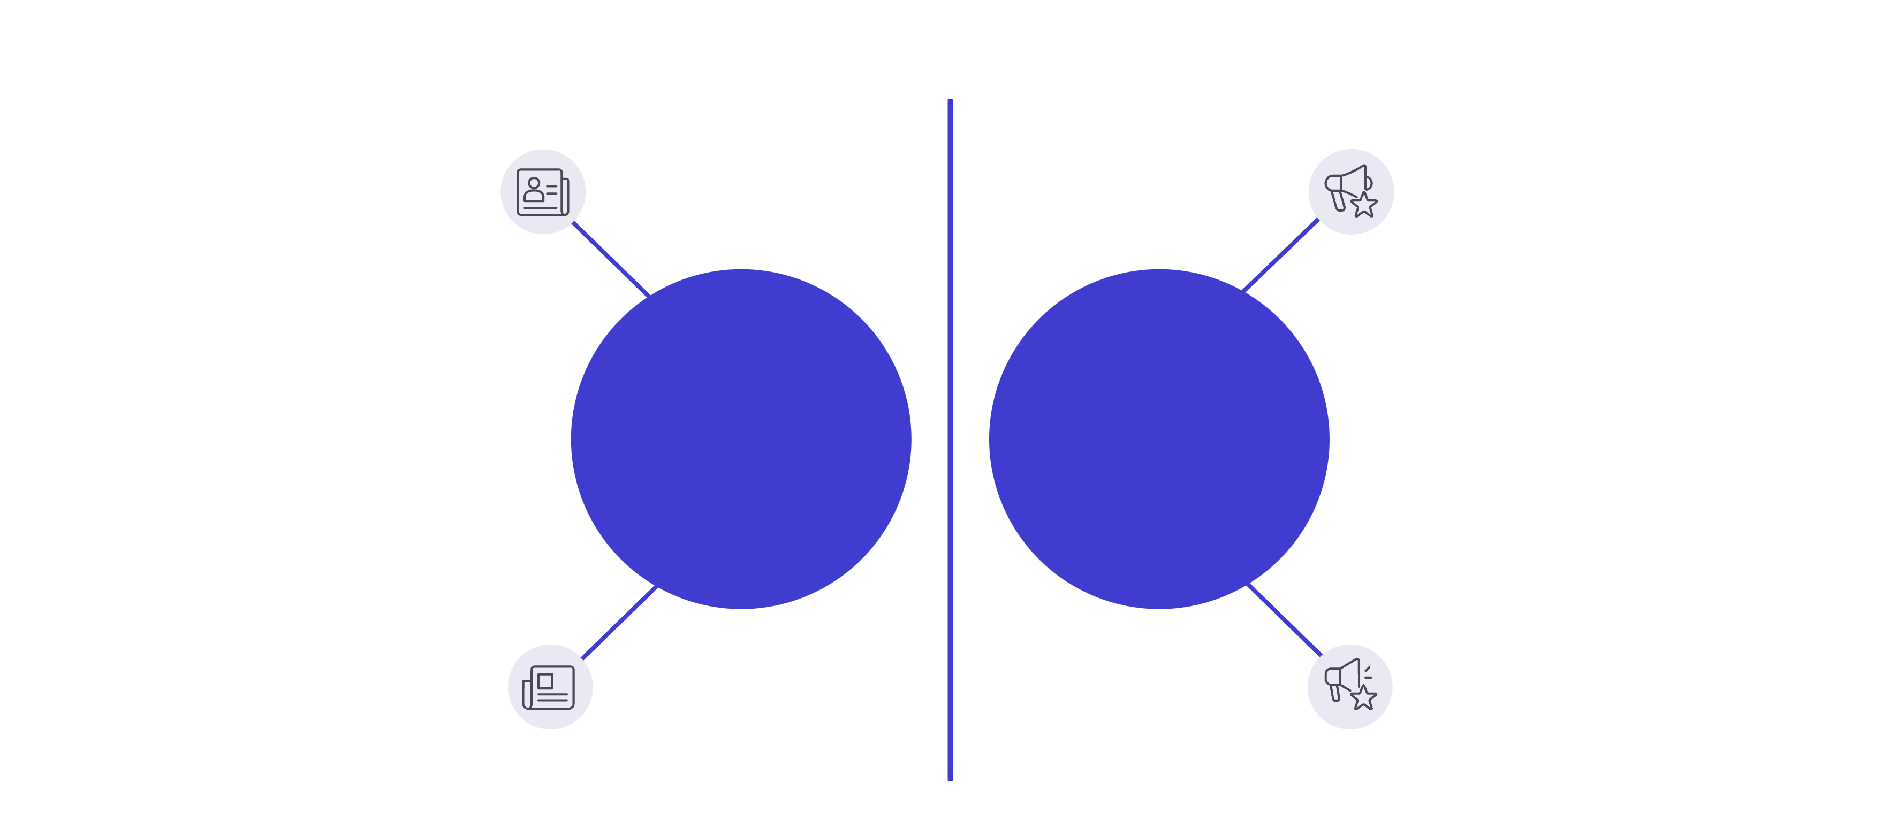




Influence on News and Information Consumption
Social media is increasingly the primary source of news for many, which has significant implications for media literacy and public discourse.
Instant distribution
Amplified falsehoods
Misinformation & Echo Chambers
Speed & Accessibility
Wider reach
Reinforced biases
The rapid spread of information, both accurate and inaccurate, poses a challenge to traditional journalism and democratic processes.

Slide 6



Economic and Business Impact
For businesses, social media is an indispensable tool for marketing, customer service, and sales.
E-commerce Integration
Customer Engagement
Targeted Advertising
Platforms now offer direct shopping features, turning social browsing into immediate purchasing.
Provides a direct channel for real-time customer support and feedback, enhancing brand loyalty.
Sophisticated algorithms allow businesses to reach highly specific demographics with personalized ads.

Slide 7

The Psychological Toll: Mental Health Concerns
While connecting people, excessive social media use has been linked to several negative mental health outcomes.
Key Concerns
Increased feelings of anxiety and depression, particularly among adolescents.
The pressure to maintain a "perfect" online persona, leading to low self-esteem.
Fear of Missing Out (FOMO) driven by constantly viewing others' curated lives.

Slide 8








The Role of Algorithms and Personalization
The content users see is heavily influenced by complex algorithms designed to maximize engagement.
Algorithm Filters
User Interaction
Prioritizes content based on predicted relevance and engagement potential.
Likes, shares, comments, and time spent viewing content.
Increased Engagement
Personalized Feed
Users spend more time on the platform, feeding more data back into the cycle.
Delivers a highly tailored stream of content, reinforcing existing views.

Slide 9
Future Trends in Social Media
The landscape is constantly evolving, with new technologies and user behaviors shaping the next generation of platforms.
Metaverse Integration
Decentralized Platforms
AI-Generated Content
Moving beyond 2D screens to immersive, shared virtual spaces for social interaction.
A shift towards platforms built on blockchain technology, offering greater user control and data privacy.
The rise of AI tools for content creation, blurring the lines between human and machine-generated posts.

Slide 10

Navigating the Digital Age Responsibly
Understanding the impact of social media requires a conscious effort to use platforms mindfully and critically.
Practice Digital Detox
Set boundaries and schedule time away from social media to improve focus and mental well-being.
Verify Information Sources
Develop media literacy skills to critically evaluate news and avoid the spread of misinformation.
Prioritize Real-World Connections
Ensure that digital interactions supplement, rather than replace, meaningful face-to-face relationships.

Slide 11
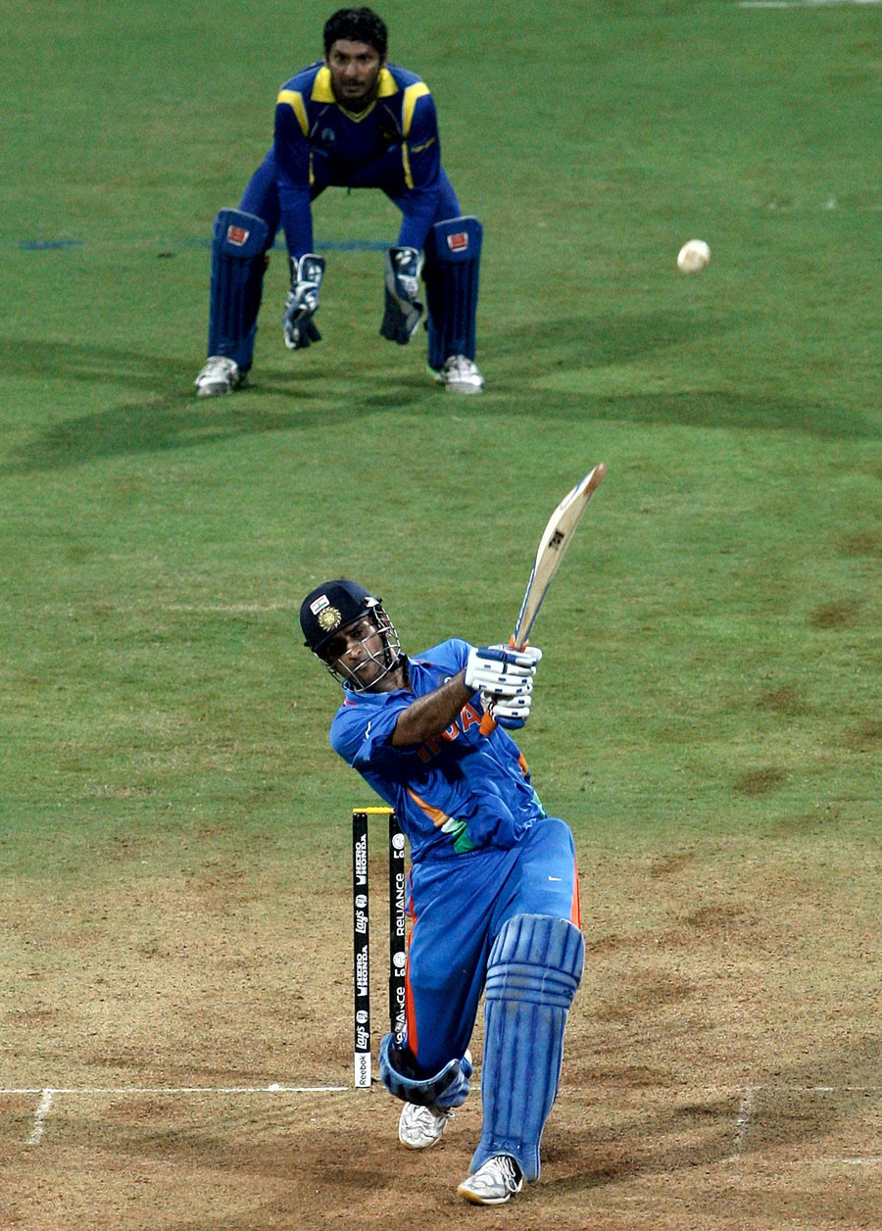
Thanku ji
This Photo by Unknown Author is licensed under CC BY

